Slide 1
Bootstrap

Slide 2
Bootstrap
Bootstrap is a free, open source front-end development framework for the creation of websites and web apps.
Designed to enable responsive development of mobile-first websites, Bootstrap provides a collection of syntax for template designs.
As a framework, Bootstrap includes the basics for responsive web development, so developers only need to insert the code into a pre-defined grid system.
The Bootstrap framework is built on Hypertext Markup Language (HTML), cascading style sheets (CSS) and JavaScript.
Web developers using Bootstrap can build websites much faster without spending time worrying about basic commands and functions.
Bootstrap developers – Mark Otto and Jacob Thornton of Twitter, though it was later declared to be an open-source project.

Slide 3
Bootstrap Framework
Advantages of Bootstrap:
Easy to use: Anybody with just basic knowledge of HTML and CSS can start using Bootstrap
Responsive features: Bootstrap's responsive CSS adjusts to phones, tablets, and desktops
Mobile-first approach: In Bootstrap 3, mobile-first styles are part of the core framework
Browser compatibility: Bootstrap is compatible with all modern browsers (Chrome, Firefox, Internet Explorer, Safari, and Opera).

Slide 4
Where to Get Bootstrap?
There are two ways to start using Bootstrap on your own web site.
Download Bootstrap from getbootstrap.com
If you want to download and host Bootstrap yourself, go to getbootstrap.com, and follow the instructions there.
Include Bootstrap from a CDN
If you don't want to download and host Bootstrap yourself, you can include it from a CDN (Content Delivery Network).
MaxCDN provides CDN support for Bootstrap's CSS and JavaScript. You must also include jQuery.

Slide 5
You must include the following Bootstrap’s CSS, JavaScript, and jQuery from MaxCDN into your web page.
<!-- Latest compiled and minified Bootstrap CSS --> <link rel="stylesheet"href="https://maxcdn.bootstrapcdn.com/bootstrap/3.3.7/css/bootstrap.min.css">
<!-- Latest compiled Bootstrap JavaScript --> <script src="https://maxcdn.bootstrapcdn.com/bootstrap/3.3.7/js/bootstrap.min.js"></script>
<!-- latest jQuery library --> <script src="https://code.jquery.com/jquery-latest.js"></script>

Slide 6
Bootstrap package contains
Scaffolding: Bootstrap provides a basic structure with Grid System, link styles, and background.
CSS: Bootstrap comes with the feature of global CSS settings, fundamental HTML elements style and an advanced grid system.
Components: Bootstrap contains a lot of reusable components built to provide iconography, dropdowns, navigation, alerts, pop-overs, and much more.
JavaScript Plugins: Bootstrap also contains a lot of custom jQuery plugins. You can easily include them all, or one by one.
Customize: Bootstrap components are customizable and you can customize Bootstrap's components, LESS variables, and jQuery plugins to get your own style.

Slide 7
Bootstrap 5 vs. Bootstrap 3 & 4
Bootstrap 5 is the newest version of Bootstrap; with new components, faster stylesheet and more responsiveness.
Bootstrap 5 supports the latest, stable releases of all major browsers and platforms. However, Internet Explorer 11 and down is not supported.
The main differences between Bootstrap 5 and Bootstrap 3 & 4, is that Bootstrap 5 has switched to JavaScript instead of jQuery.

Slide 8
Bootstrap uses HTML elements and CSS properties, so you have to add the HTML 5 doctype at the beginning of the page with lang attribute and correct character set.
EXAMPLE
<!DOCTYPE html>
<html lang="en"> <head>
<title>Bootstrap Example</title>
<meta charset="utf-8">
<meta name="viewport" content="width=device-width, initial-scale=1">
<link href="https://cdn.jsdelivr.net/npm/bootstrap@5.1.3/dist/css/bootstrap.min.css" rel="stylesheet">
<script src="https://cdn.jsdelivr.net/npm/bootstrap@5.1.3/dist/js/bootstrap.bundle.min.js"></script>
</head> <body> <div class="container">
<h1>My First Bootstrap Page</h1>
<p>This part is inside a .container class.</p>
<p>The .container class provides a responsive fixed width container.</p>
<p>Resize the browser window to see that the container width will change at different breakpoints.</p> </div>
</body></html>

Slide 9
Bootstrap is mobile friendly: Bootstrap 3 is designed to be responsive to mobile devices.
Mobile-first styles are part of the core framework of Bootstrap. You have to add the following <meta> tag inside the <head> element for proper rendering and touch zooming:
<meta name="viewport" content="width=device-width, initial-scale=1">
The "width=device-width" part is used to set the width of the page to follow the screen-width of the device (vary according to the devices).
The initial-scale=1 part is used to set the initial zoom level when the page is first loaded by the browser.

Slide 10
Bootstrap 5 Containers
You learned from the previous chapter that Bootstrap requires a containing element to wrap site contents.
Containers are used to pad the content inside of them, and there are two container classes available:
The .container class provides a responsive fixed width container
The .container-fluid class provides a full width container, spanning the entire width of the viewport.

Slide 11
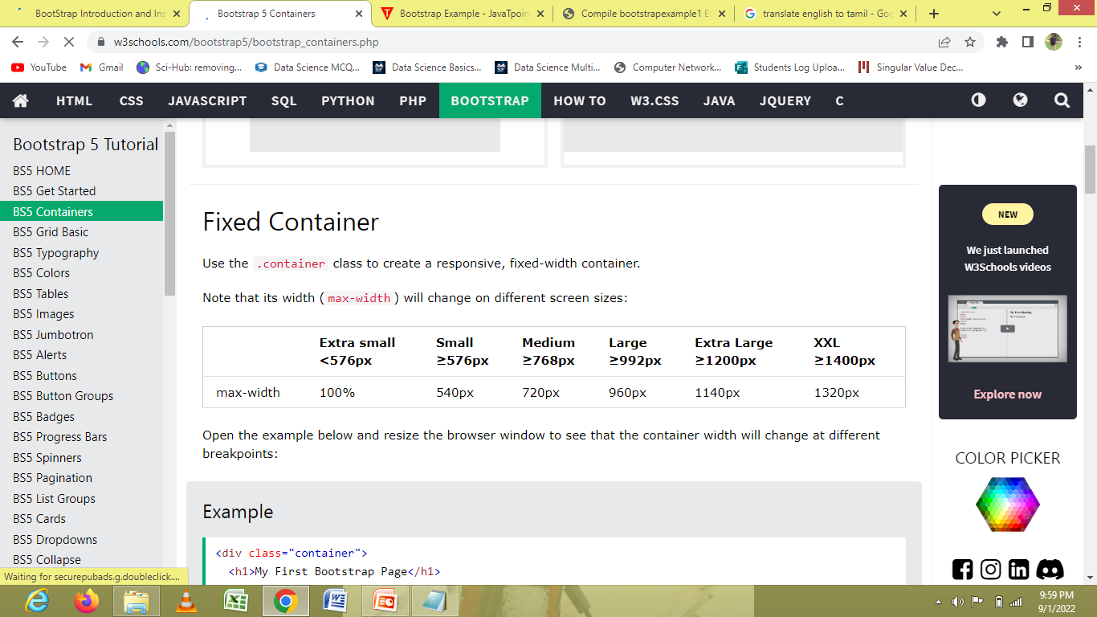
container class

Slide 12
.container-fluid Class
Fluid Container
Use the .container-fluid class to create a full width container, that will always span the entire width of the screen (width is always 100%):

Slide 13
Container Padding
Containers have left and right padding, with no top or bottom padding.
Therefore, we often use spacing utilities, such as extra padding and margins to make them look even better.
For example, .pt-5 means "add a large top padding":
Example:
<div class="container pt-5"></div>

Slide 14
Container Border and Color
Other utilities, such as borders and colors, are also often used together with containers:

Slide 15
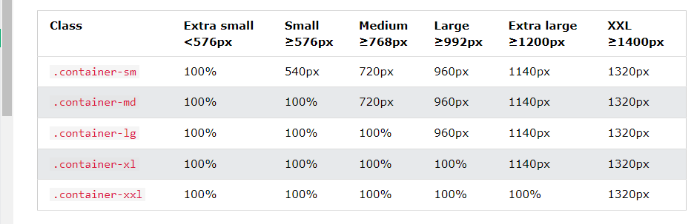
Responsive Containers
Responsive Containers
You can also use the .container-sm|md|lg|xl classes to determine when the container should be responsive.
The max-width of the container will change on different screen sizes/viewports:

Slide 16
Bootstrap 5 Grid System
Bootstrap's grid system uses a series of containers, rows, and columns to layout and align content.
It is widely used to design layout and content structure in print design.
Bootstrap's grid system is built with flexbox and allows up to 12 columns across the page.
If you do not want to use all 12 columns individually, you can group the columns together to create wider columns:

Slide 17
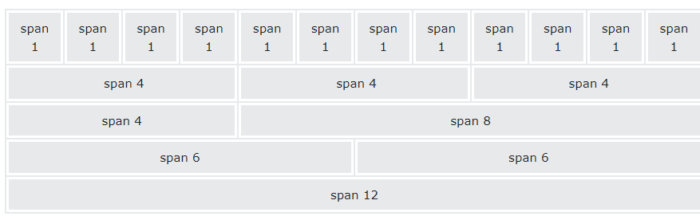
The grid system is responsive, and the columns will re-arrange automatically depending on the screen size.
Make sure that the sum adds up to 12 or fewer (it is not required that you use all 12 available columns).

Slide 18
Grid Classes
The Bootstrap 5 grid system has six classes:
.col- (extra small devices - screen width less than 576px) (Mobile)
.col-sm- (small devices - screen width equal to or greater than 576px) (Tablets)
.col-md- (medium devices - screen width equal to or greater than 768px) (Desktop)
.col-lg- (large devices - screen width equal to or greater than 992px) (Larger Desktop)
.col-xl- (xlarge devices - screen width equal to or greater than 1200px)
.col-xxl- (xxlarge devices - screen width equal to or greater than 1400px)
The classes above can be combined to create more dynamic and flexible layouts.

Slide 19
Basic Structure of a Bootstrap 5 Grid
<!-- Control the column width, and how they should appear on different devices --> <div class="row"> <div class="col-*-*"></div> <div class="col-*-*"></div> </div> <div class="row"> <div class="col-*-*"></div> <div class="col-*-*"></div> <div class="col-*-*"></div> </div> <!-- Or let Bootstrap automatically handle the layout --> <div class="row"> <div class="col"></div> <div class="col"></div> <div class="col"></div> </div>

Slide 20
First example: create a row (<div class="row">). Then, add the desired number of columns (tags with appropriate .col-*-* classes). The first star (*) represents the responsiveness: sm, md, lg, xl or xxl, while the second star represents a number, which should add up to 12 for each row.
Second example: instead of adding a number to each col, let bootstrap handle the layout, to create equal width columns: two "col" elements = 50% width to each col, while three cols = 33.33% width to each col. Four cols = 25% width, etc. You can also use .col-sm|md|lg|xl|xxl to make the columns responsive.

Slide 21
Tables
A table is an arrangement of information or data, typically in rows and columns, or possibly in a more complex structure.
Tables are widely used in communication, research, and data analysis.

Slide 22
Bootstrap Basic Table
A basic Bootstrap table has a light padding and only horizontal dividers.
The .table class adds basic styling to a table
Striped Rows
The .table-striped class adds zebra-stripes to a table
Bordered Table
The .table-bordered class adds borders on all sides of the table and cells
Hover Rows
The .table-hover class adds a hover effect (grey background color) on table rows

Slide 23
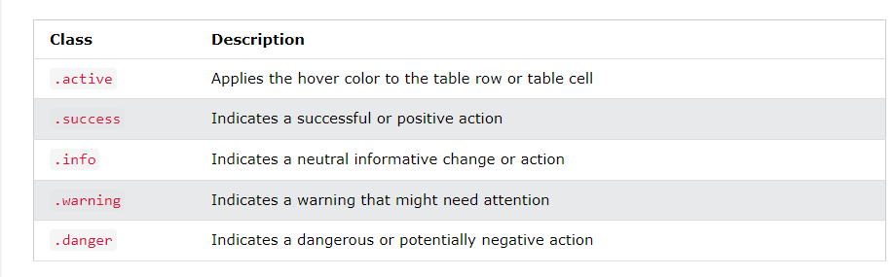
Contextual Classes
Contextual classes can be used to color table rows (<tr>) or table cells (<td>)

Slide 24
Responsive Tables
The .table-responsive class creates a responsive table. The table will then scroll horizontally on small devices (under 768px). When viewing on anything larger than 768px wide, there is no difference.

Slide 25
Bootstrap Images
Its used to insert the image shapes.
Bootstrap Images
Rounded Corners. The .img-rounded class adds rounded corners to an image (IE8 does not support rounded corners)
Circle. The .img-circle class shapes the image to a circle (IE8 does not support rounded corners)
Thumbnail. The .img-thumbnail class shapes the image to a thumbnail
Responsive Images.

Slide 26
Rounded Corners
The .img-rounded class adds rounded corners to an image (IE8 does not support rounded corners)
Example:
<img src="cinqueterre.jpg" class="img-rounded" alt="Cinque Terre">
Circle
The .img-circle class shapes the image to a circle.
Example:
<img src="cinqueterre.jpg" class="img-circle" alt="Cinque Terre">
Thumbnail
The .img-thumbnail class shapes the image to a thumbnail
Example:
<img src="cinqueterre.jpg" class="img-thumbnail" alt="Cinque Terre">

Slide 27
Responsive Images
Images come in all sizes. So do screens. Responsive images automatically adjust to fit the size of the screen.
Create responsive images by adding an .img-responsive class to the <img> tag. The image will then scale nicely to the parent element.
The .img-responsive class applies display: block; and max-width: 100%; and height: auto; to the image.
Example:
<img class="img-responsive" src="img_chania.jpg" alt="Chania">

Slide 28
BS Alerts
Alert messages can be used to notify the user about something special: danger, success, information or warning.
Bootstrap provides an easy way to create predefined alert messages:
Alerts are created with the .alert class, followed by one of the four contextual classes .alert-success, .alert-info, .alert-warning or .alert-danger:

Slide 29
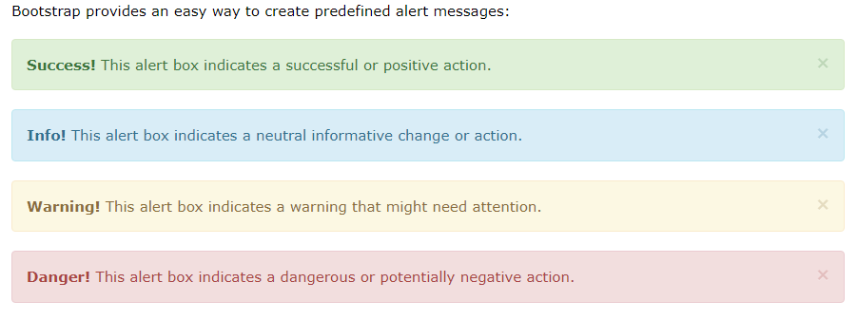

Slide 30
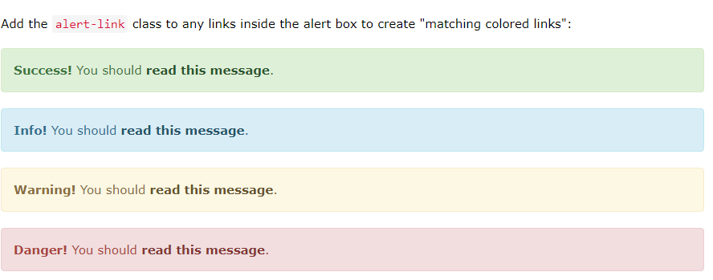
Alert-Link

Slide 31
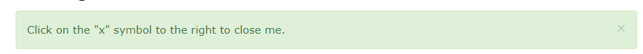
Closing Alerts
To close the alert message, add a .alert-dismissible class to the alert container. Then add class="close" and data-dismiss="alert" to a link or a button element (when you click on this the alert box will disappear)

Slide 32
Bootstrap Forms
Bootstrap's Default Settings
Form controls automatically receive some global styling with Bootstrap:
All textual <input>, <textarea>, and <select> elements with class .form-control have a width of 100%.
Bootstrap Form Layouts
Bootstrap provides three types of form layouts:
Vertical form (this is default)
Horizontal form
Inline form
Standard rules for all three form layouts:
Wrap labels and form controls in <div class="form-group"> (needed for optimum spacing)
Add class .form-control to all textual <input>, <textarea>, and <select> elements

Slide 33
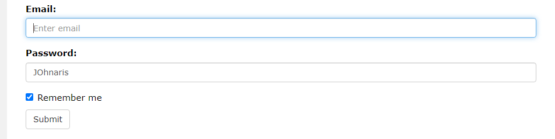
Bootstrap Vertical Form (default)
The following example creates a vertical form with two input fields, one checkbox, and a submit button.

Slide 34
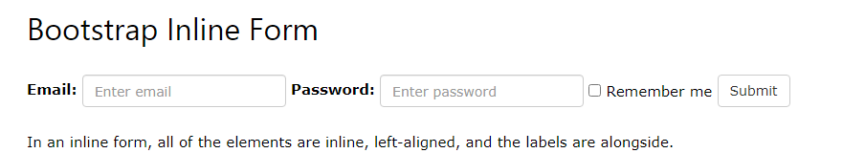
Bootstrap Inline Form
In an inline form, all of the elements are inline, left-aligned, and the labels are alongside.
Note: This only applies to forms within viewports that are at least 768px wide!
Additional rule for an inline form:
Add class .form-inline to the <form> element
The following example creates an inline form with two input fields, one checkbox, and one submit button

Slide 35
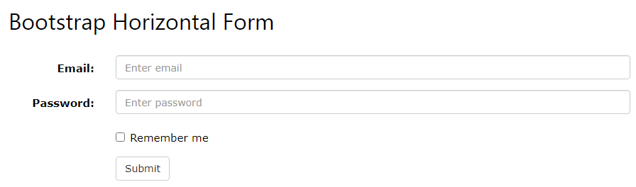
Bootstrap Horizontal Form
A horizontal form means that the labels are aligned next to the input field (horizontal) on large and medium screens.
On small screens (767px and below), it will transform to a vertical form (labels are placed on top of each input).
Additional rules for a horizontal form:
Add class .form-horizontal to the <form> element
Add class .control-label to all <label> elements

